Slide 1
Experiencia #1
SPAN 101 Spring 2013

Slide 2
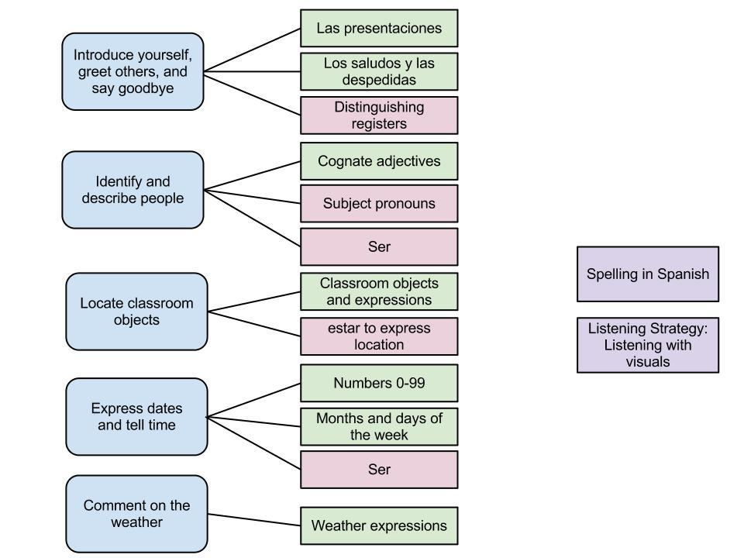
Repaso - Capítulo preliminar

Slide 3
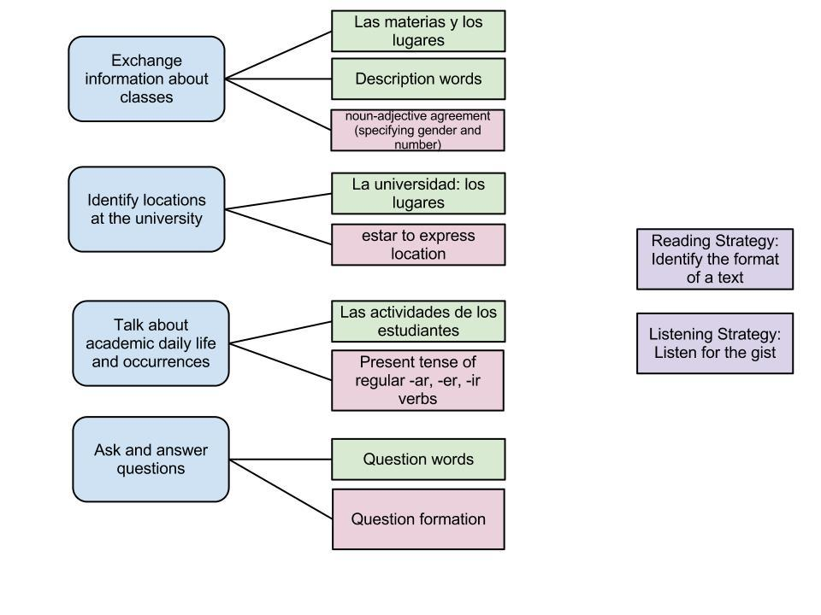
Repaso - Capítulo 1

Slide 4
Experiencia #1
For Experiencia #1 you will need to talk with your classmates to complete the available class schedule for an upcoming semester. Use the information you have to help others complete their schedules and ask others for the proper information to complete your schedule as well as the activities that your professor and friends do in their free time. Your end goal is to use what you know in Spanish to fill in all of the missing information during class today. Once completed, you should turn in your sheet to me and may go.

Slide 5
Guidelines
Your interactions will be evaluated by your professor. For each interaction you must:
greet your classmate with a saludo
ask the appropriate question
answer any questions your classmate might have
write all answers in words (including la hora), be careful of spelling
end the interaction appropriately with a despedida
You should only give information based on the printed sheet you have, not information gathered from others.
If you do not have the printed information answer: No puedo decirte.
You MUST speak only Spanish. If your instructor hears you speaking English you will get a colored dot added to your sheet. Three colored dots will result in a 10 point reduction of your final grade.
DO NOT look at others sheets or allow others to look at your sheet. Any visual sharing of sheets will result in an automatic zero for Experiencia #1 and is considered cheating.

Slide 6
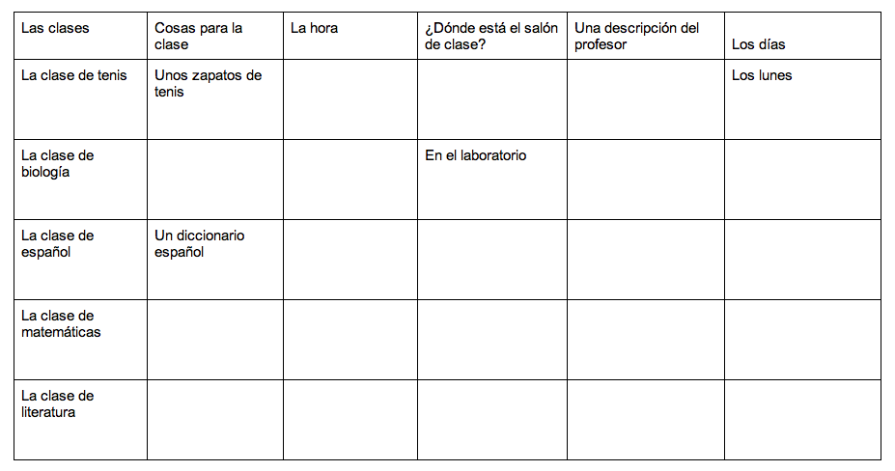
Two points will be given for each correct square.
+1 point correct content
+1 point correct form (spelling, accents, etc.)
Four points will be given for each correct activity.
+1 point correct content
+2 point correct verb form
+1 point other mechanics (spelling, accents, etc.)
Up to three points awarded for each adequate saludos, pregunta or despedida as evaluated by your instructor.

